Slide 1

Blockchain Varieties
Public, Private, and Consortium Networks

Slide 2
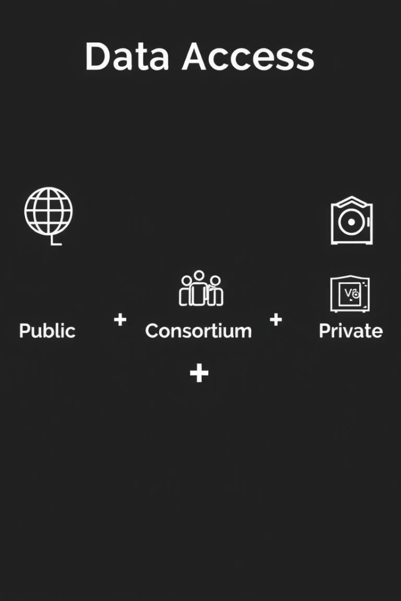
Why Blockchain Types Matter
Not all blockchains are the same
Different use cases need different structures
Each type offers unique features.
One size does not fit all solutions.
Understanding access control and governance is key
Crucial for effective implementation.

Slide 3

What Defines a Blockchain Type?
Who can participate?
Who validates transactions?
Determines network openness.
Ensures data integrity and security.
Who has control over the data?
Defines governance structure.

Slide 4

Public Blockchains
Open & Decentralized
Anyone can join permissionlessly. These networks are transparent and trustless. They are powered by Proof-of-Work or Proof-of-Stake consensus.
Bitcoin
Ethereum

Slide 5




Real-Life Analogy – Public Blockchain
Like a Public Park
All activities visible
Shared maintenance
Anyone can walk in freely.
Transparency for everyone.
Like mining fees for upkeep.

Slide 6

Private Blockchains
Controlled & Restricted
Only invited nodes can participate. A central authority decides all access. These networks offer higher speed and privacy.
Hyperledger Fabric

Slide 7




Real-Life Analogy – Private Blockchain
Access by employees only
High performance
All data logged internally

Slide 8

Consortium Blockchains
Shared Between Organizations
These are permissioned but multi-party networks. They feature joint control and validation among members. Used for industry-wide cooperation.
R3 Corda (consortium)
Energy Web
IBM Food Trust

Slide 9






Real-Life Analogy – Consortium Blockchain
Shared rules and trust
Agreement on governance.
Like a Joint Venture
Multiple companies form a partnership.
Balanced control
No single entity dominates.

Slide 10
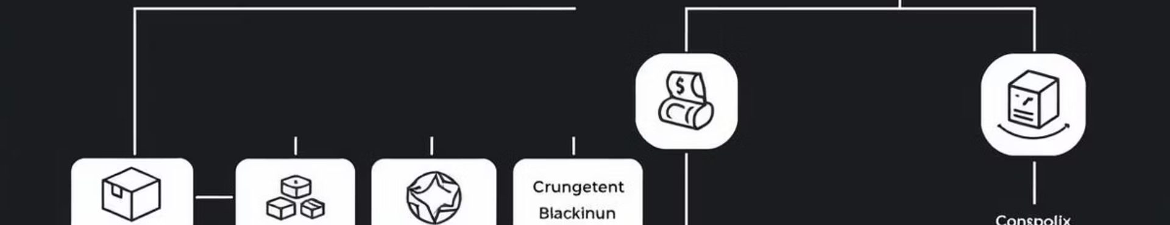
When to Use Each Type?
Consortium
Private
Insurance, Energy Markets.
Public
Banking, Pharma Supply Chains.
Crypto, NFTs, DApps.

